Slide 1
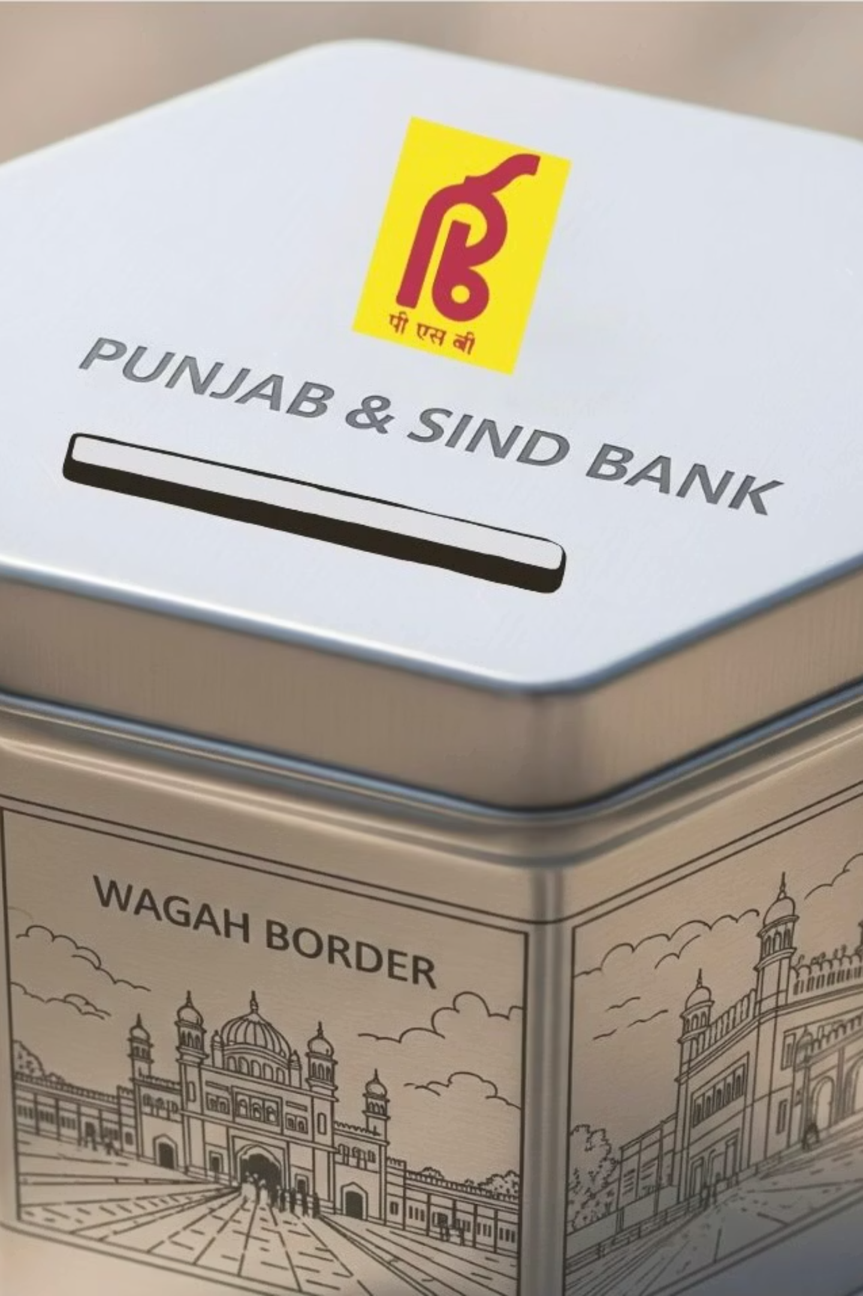
Empowering Financial Futures: Punjab & Sind Bank App
This presentation outlines the development of a mobile application for Punjab & Sind Bank, aimed at enhancing financial literacy and fraud awareness among its customers. The app provides practical financial tools and educational content, designed to be user-friendly and accessible on both Android and iOS platforms.

Slide 2

Project Overview and Objectives
Objective
To empower Punjab & Sind Bank customers with financial literacy, fraud awareness, and practical financial tools through a user-friendly mobile application.
Target Audience
Punjab & Sind Bank customers and the general public seeking to improve their financial knowledge and security.
Platform & Branding
Cross-platform mobile app (Android & iOS) built with Flutter and Dart. Uses the official Punjab & Sind Bank logo and branding colors: Green, Yellow, Red.

Slide 3
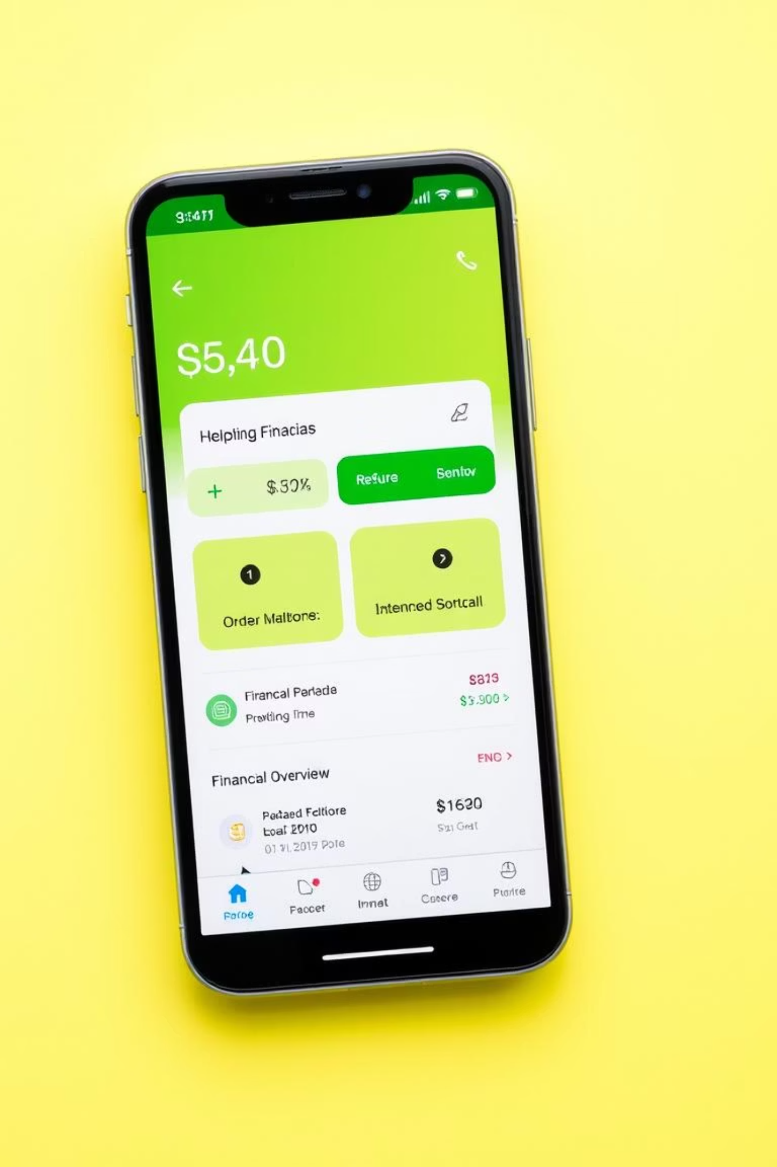
Key Features: Core Navigation
Welcome/Splash Screen
Displays the Punjab & Sind Bank logo and app name while the application loads, ensuring a branded and smooth start to the user experience.
Home Screen
Offers quick actions for popular tools, a summarized financial overview, and a placeholder for recent transactions, providing a personalized dashboard.
Goals Tracking
Allows users to set, edit, and monitor personal financial goals with visual progress indicators, fostering a sense of achievement and motivation.
Profile & Settings
Enables users to manage their profile and app preferences, ensuring a customizable and secure experience tailored to individual needs.

Slide 4
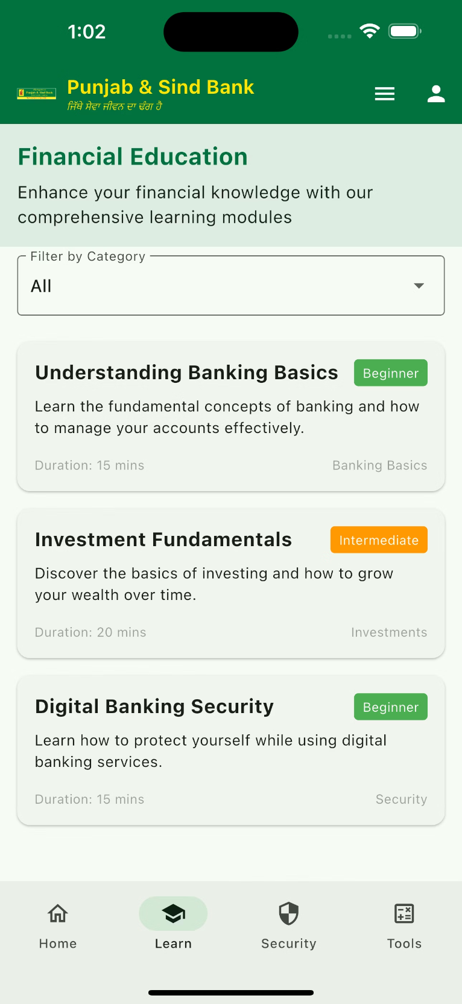
Learning Modules for Financial Literacy
The app's interactive learning modules are designed to educate users on a variety of essential financial literacy topics. These engaging and easy-to-understand lessons cater to users with diverse levels of financial knowledge.
1
Interactive Lessons
The modules feature interactive lessons that cover fundamental financial concepts in an immersive way, helping users truly grasp and retain the material.
2
Progress Tracking
Users can track their completed modules and monitor their overall financial literacy learning journey, ensuring they stay on top of their educational goals.
3
Comprehensive Curriculum
The learning content covers a wide range of essential financial topics, including budgeting, saving, investing, and debt management, empowering users with holistic financial knowledge.

Slide 5



Comprehensive Fraud Awareness
Information on Scams
Detailed information on common banking frauds and scams, helping users identify and avoid potential threats.
Safety Tips & Practices
Practical tips and best practices to stay safe from financial fraud, empowering users with defensive strategies.
Real-Life Case Studies
Engaging real-life fraud case studies to illustrate how scams work and how to prevent falling victim to them.
This section is crucial for protecting customers in an increasingly digital financial landscape, providing them with the knowledge to safeguard their assets.

Slide 6

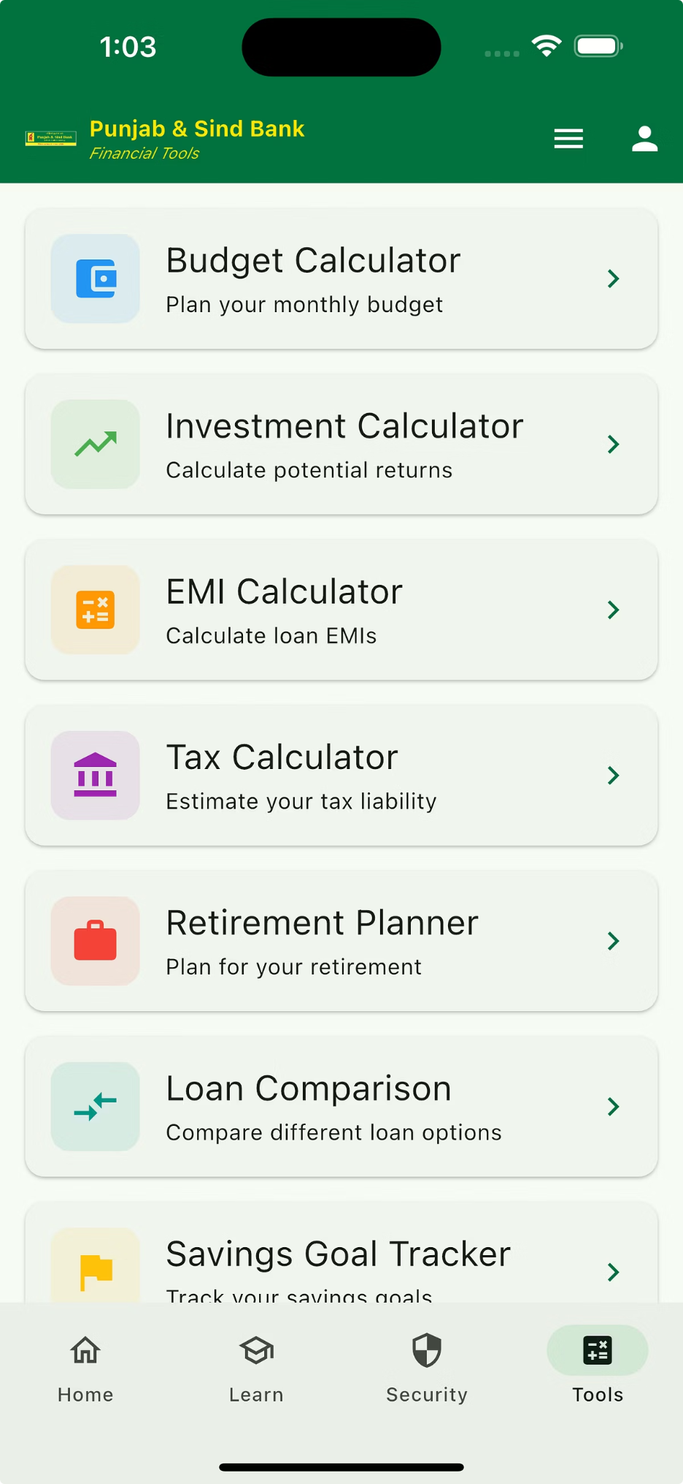
Financial Tools: Empowering Decisions
The app provides a comprehensive suite of financial tools, all accessible from a dedicated "Tools" section. These calculators and planners are designed to assist users in making informed financial decisions and managing their money effectively.
Calculators
EMI Calculator, Budget Calculator, Investment Calculator, Tax Calculator, Insurance Premium Calculator.
Planners
Retirement Planner, Savings Goal Tracker.
Simulators
Credit Score Simulator, Loan Comparison.

Slide 7

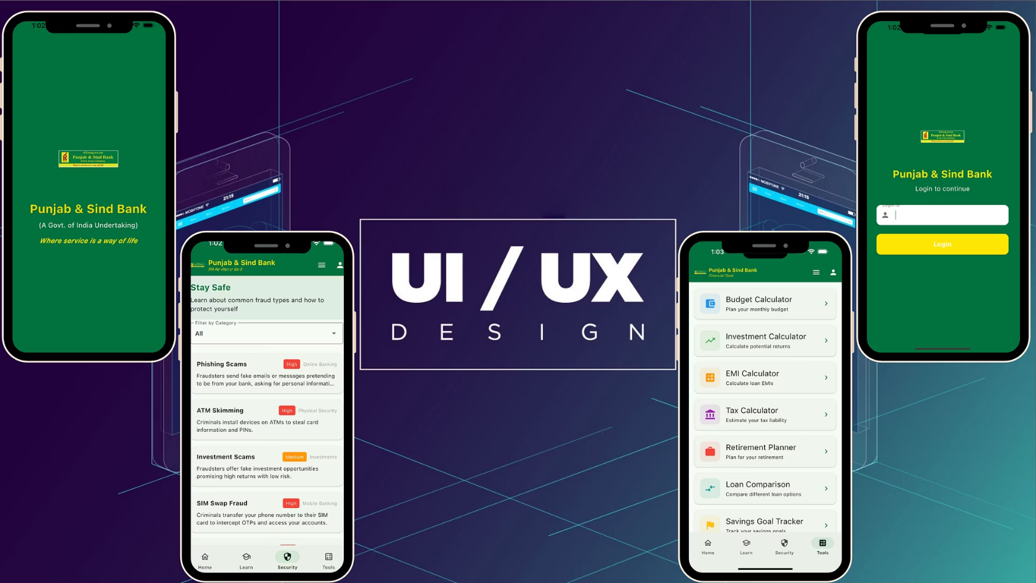
Technology Stack and UI/UX Principles
Technology Stack
UI/UX Principles
Frontend: Flutter (Dart) for cross-platform compatibility.
Modern, clean, and accessible design for optimal user experience.
State Management: Provider for efficient data flow.
Consistent use of bank branding (green, yellow, and red) for visual identity.
Assets: Custom icons, Punjab & Sind Bank logo, and relevant images.
Navigation: Intuitive bottom navigation bar for easy access to Home, Tools, Learning, and Profile sections.
Simple navigation ensures ease of use for all customer segments.
Responsive layouts guarantee functionality across various device sizes.

Slide 8




Current Enhancements
The Punjab & Sind Bank app is currently undergoing key enhancements aimed at enriching the user experience and expanding its overall functionality, all while maintaining a scalable design for future growth.
Account Integration
Push Notifications
Seamless integration with real bank accounts for direct transaction data access.
Timely alerts for fraud warnings and reminders for learning modules.
Multi-Language Support
AI
Expansion to include English, Hindi, and Punjabi for broader accessibility.
Introduction of artificial intelligence for comprehensive fail safe security, budget planning and goal path accessibility .

Slide 9
AI-Powered Multi-Language Banking
Experience
Built with Flutter
A robust, cross-platform mobile framework enabling seamless performance, smooth animations, and rapid development across Android & iOS devices
NLP-Driven Language Support
Real-time language detection and interaction using NLP (Natural Language Processing), supporting English, Hindi, and Punjabi—enhancing accessibility for all users.
Smart Language Interactions
AI models interpret user input in natural language, enabling:
• Voice and text-based queries
• Personalized financial guidance
• Context-aware chatbot conversations
Inclusive + Secure
Multilingual support doesn’t compromise security—AI ensures fraud detection, secure login flows, and language-consistent user experiences.

Slide 10
Upcoming AI Enhancements
The Punjab & Sind Bank app is designed with scalability in mind, with several key enhancements planned for future development to further enrich the user experience and expand its utility.
Smart Account Integration
Advanced Fraud Detection
AI/ML models will automate transaction categorization, detect unusual patterns, and offer financial insights tailored to user behavior.
AI/ML algorithms will proactively monitor transaction anomalies in real time, enabling faster threat detection and secure banking with minimal user intervention.
Personalized Learning Insights
AI-Powered Financial Planning
AI will analyze user behavior and learning patterns to recommend tailored educational modules, financial literacy tips, and progress tracking for continuous improvement.
AI will provide users with automated budget suggestions, savings goals, and predictive analysis for smarter decision-making.

Slide 11

Summary: Empowering Digital Innovation
The Punjab & Sind Bank Financial Literacy & Fraud Awareness App is a strategic initiative designed to make financial education and security accessible, engaging, and practical for all customers. This application directly supports the bank’s mission of customer empowerment and digital innovation.
Enhances financial knowledge and security.
Provides practical tools for money management.
Built on a robust and modern technology stack.
Designed with a user-centric UI/UX approach.

Slide 12

Key Takeaways and Next Steps
The Punjab & Sind Bank app represents a significant step towards digital empowerment for its customers. Our next steps involve rigorous testing, user feedback integration, and a phased rollout to ensure a seamless launch and continuous improvement.
Final Development & Testing
Complete remaining features and conduct comprehensive quality assurance.
User Acceptance Testing
Gather feedback from a pilot group to refine the app based on real-world usage.
Official Launch
Announce and release the app on Android and iOS platforms to the public.
Post-Launch Support & Updates
Provide ongoing maintenance, bug fixes, and introduce planned future enhancements.

